Slide 1


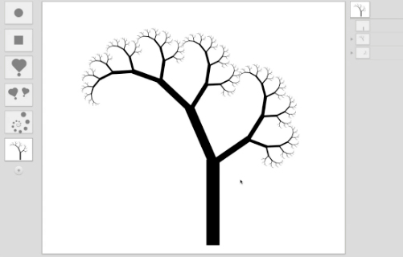
Recursive Drawing
The Beauty and Joy of Computing Lecture #10 Recursion II
Toby Shachman created this amazing spatial programming language called “Recursive Drawing” that allows you to create drawings (even recursive ones) without typing a line of code. It’s a great example of a next-generation interface…
recursivedrawing.com

Slide 2

Overview
www.worldofescher.com/gallery/A13.html
Recursion
Factorial Demo
Fibonacci Demo
Count Change

Slide 3
Recursion:
Factorial

Slide 4
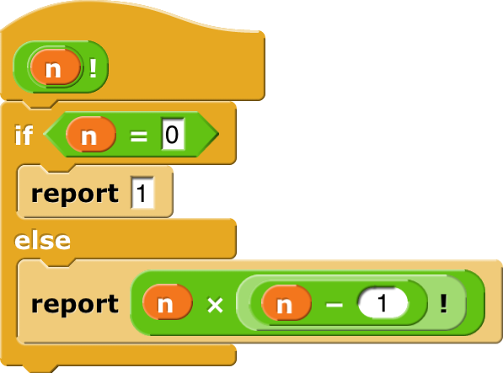
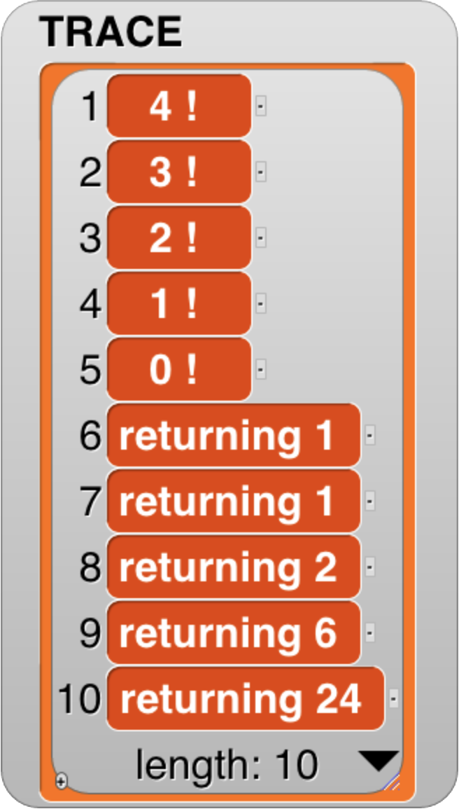
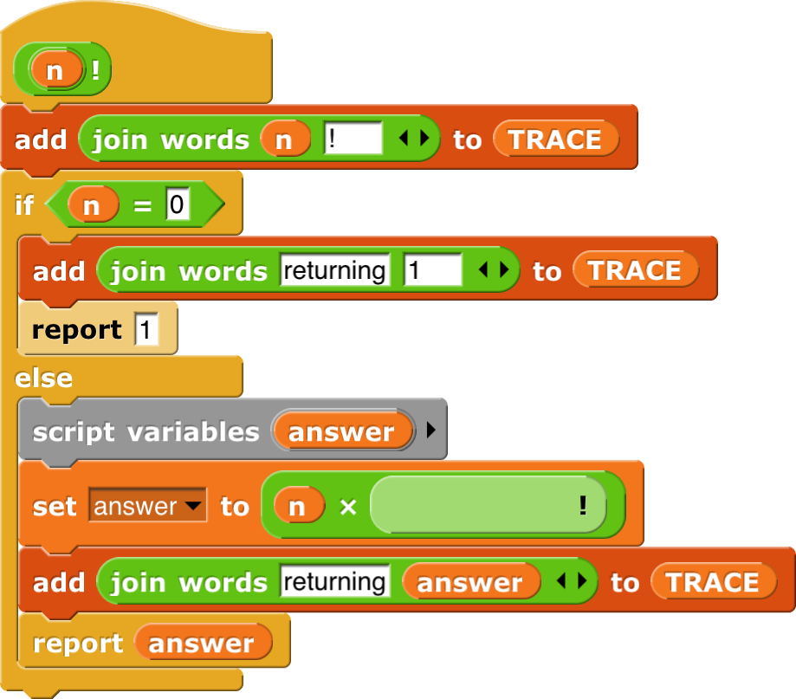
Recursion: Demonstrating n!
www.bogotobogo.com/cplusplus/images/quiz/recursion_factorial.png
Factorial(n) = n! Inductive definition:
n! = 1 , n = 0
n! = n * (n-1)! , n > 0
Let’s act 4! out…
“contractor” model
4!
n | n!
0 | 1
1 | 1
2 | 2
3 | 6
4 | 24

Slide 5
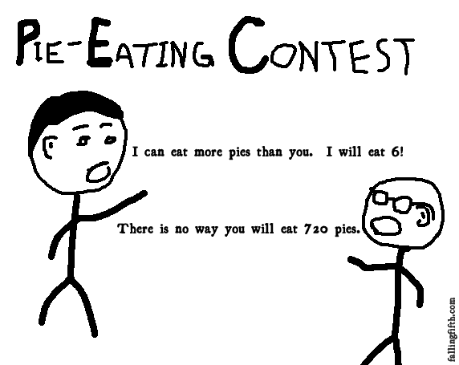
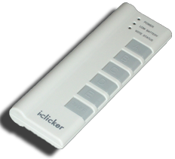
Order of growth of # of calls of n!
Constant
Logarithmic
Linear
Quadratic
Exponential
(source: FallingFifth.com)

Slide 6
Recursion:
Fibonacci

Slide 7

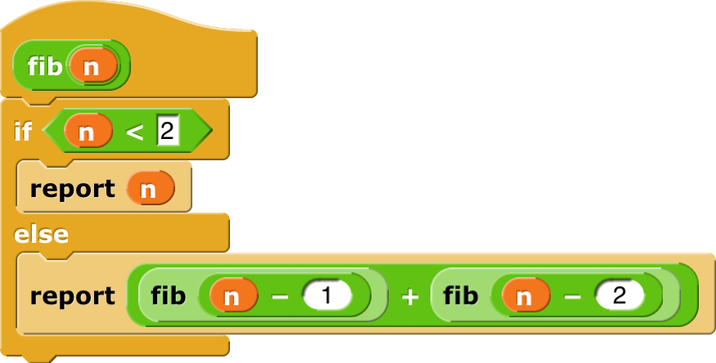
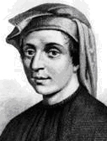
Recursion: Demonstrating fib(n)
en.wikipedia.org/wiki/Fibonacci_number www.ics.uci.edu/~eppstein/161/960109.html
Inductive definition:
fib(n) = n , n < 2
fib(n) = fib(n-1)+fib(n-2) , n ≥ 2
Let’s act it out…
“contractor” model
fib(5)
n | fib(n)
0 | 0
1 | 1
2 | 1
3 | 2
4 | 3
5 | 5
Let’s now: trace… (gif from Ybungalobill@wikimedia)

Slide 8
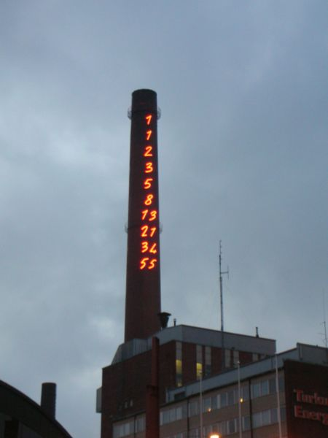
Order of growth of # of calls of fib(n)
Constant
Logarithmic
Linear
Quadratic
Exponential
Chimney of Turku Energia, Turku, Finland featuring Fibonacci sequence in 2m high neon lights. By Italian artist Mario Merz for an environmental art project. (Wikipedia)

Slide 9
Recursion:
Count Change

Slide 10
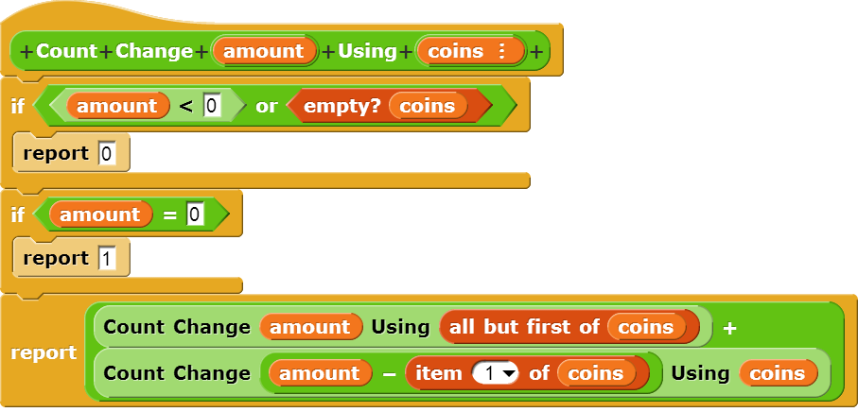
Counting Change (thanks to BH)
Given coins {50, 25, 10, 5, 1} how many ways are there of making change?
5
2 (N, 5P)
10
4 (D, 2N, N5P, 10P)
15
6 (DN, D5P, 3N, 2N5P, 1N10P, 15P)
100?

Slide 11
Call Tree for “Count Change 10 (10 5 1)”
⬅ Skip Coin
Use Coin ➔
10 (10 5 1)
10 (5 1)
10 (1)
5 (5 1)
0 (10 5 1)
10 ()
9 (1)
0
8 (1)
9 ()
0
8 ()
7 (1)
0
5 (1)
0 (5 1)
1
7 ()
0
6 (1)
6 ()
0
5 (1)
5 ()
0
4 (1)
4 ()
0
3 (1)
3 ()
0
2 (1)
2 ()
0
1 (1)
1 ()
0
0 (1)
1
1
5 ()
0
4 (1)
4 ()
0
3 (1)
3 ()
0
2 (1)
2 ()
0
1 (1)
1 ()
0
0 (1)
1
☑

Slide 12
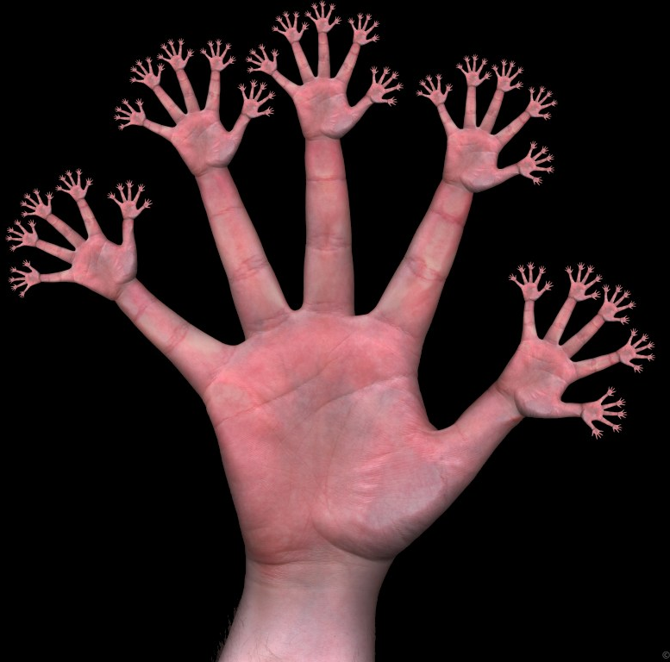
“I understood Count Change”
Strongly agree
Agree
Neutral
Disagree
Strongly disagree
www.nilkanth.com/my-uploads/200508/dactylfractal107.jpg

Slide 13
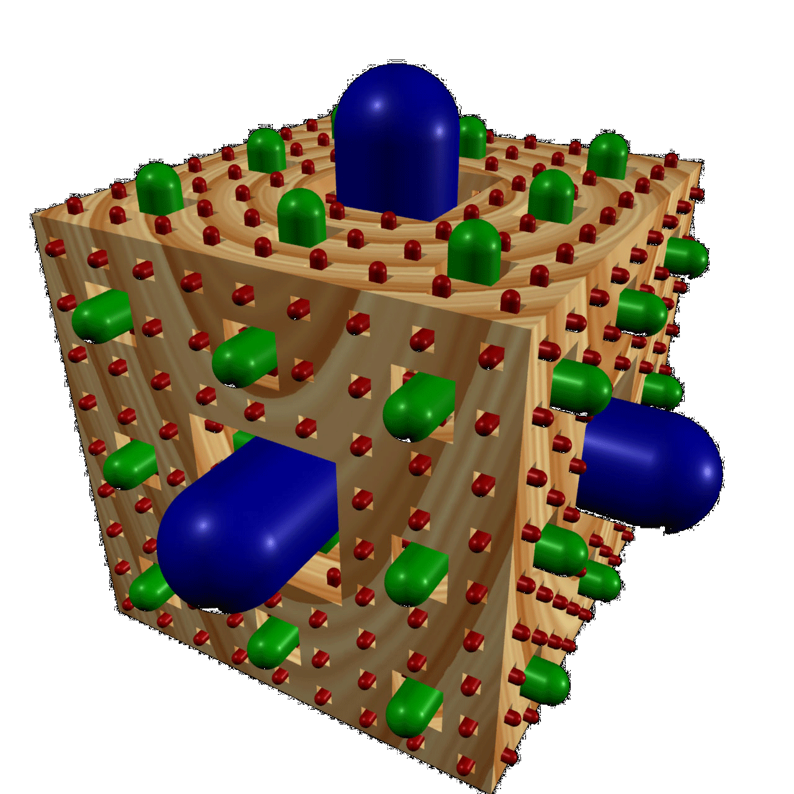
Summary
It’s important to understand the machine model
It’s often the simplest way to solve many problems
Esp if recursive in nature!
Remember, trust it!
Recursion is a very powerful idea, often separates good from great (you’re great!)
Menger Cube by Dan Garcia

